Slide 1
Chapter 2
E-Marketplaces: Structures, Mechanisms, Economics, and Impacts

Slide 2
Learning Objectives
Define e-marketplaces and list their components.
List the major types of e-marketplaces and describe their features.
Describe the various types of EC intermediaries and their roles.
Describe electronic catalogs, shopping carts, and search engines.
Describe the major types of auctions and list their characteristics.

Slide 3
Learning Objectives
Discuss the benefits, limitations, and impacts of auctions.
Describe bartering and negotiating online.
Define m-commerce and explain its role as a market mechanism.
Discuss competition in the digital economy.
Describe the impact of e-marketplaces on organizations and industries.

Slide 4
E-Marketplaces
e-marketplace
An online market, usually B2B, in which buyers and sellers exchange goods or services; the three types of
e-marketplaces are private, public, and consortia

Slide 5
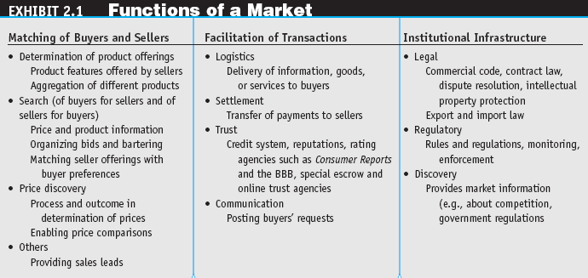
E-Marketplaces

Slide 6
E-Marketplaces
marketspace
A marketplace in which sellers and buyers exchange goods and services for money (or for other goods and services) but do so electronically

Slide 7
E-Marketplaces
E-Marketplace Components and Participants
Customers
Sellers
Products and services
digital products
Goods that can be transformed to digital format and delivered over the Internet
Infrastructure
Front end
Back end
Intermediaries
Third parties that operates between sellers and buyers
Other business partners
Support services

Slide 8
E-Marketplaces
front end
The portion of an e-seller’s business processes through which customers interact, including the seller’s portal, electronic catalogs, a shopping cart, a search engine, and a payment gateway
back end
The activities that support online order fulfillment, inventory management, purchasing from suppliers, payment processing, packaging, and delivery

Slide 9
Types of E-Marketplaces: From Storefronts to Portals
Electronic Storefronts
storefront
A single company’s Web site where products or services are sold
e-mall (online mall)
An online shopping center where many online stores are located

Slide 10
Types of E-Marketplaces: From Storefronts to Portals
Types of E-Marketplaces
private e-marketplaces
Online markets owned by a single company; may be either sell-side and/or buy-side e-marketplaces
public e-marketplaces
B2B marketplaces, usually owned and/or managed by an independent third party, that include many sellers and many buyers; also known as exchanges

Slide 11
Types of E-Marketplaces: From Storefronts to Portals
information portal
A single point of access through a Web browser to business information inside and/or outside an organization
Types of Portals
Commercial (public)
Corporate
Publishing
Personal

Slide 12
Transactions, Intermediation, and Process in E-Commerce
The Roles and Value of Intermediaries in E-marketplaces
Intermediaries link sellers and buyers and play an important role in commerce by providing value-added activities and services (usually for a fee)

Slide 13
Transactions, Intermediation, and Process in E-Commerce
On-line Intermediaries
Broker
a company that facilitates transactions between buyers and sellers
Infomediaries
Electronic intermediaries that gather and organize large amounts of data and provide and/or control information flow in cyberspace, often aggregating information and selling it to others

Slide 14
Transactions, Intermediation, and Process in E-Commerce
Intermediaries can address the following five important limitations of direct interaction:
Search costs
Lack of privacy
Incomplete information
Contract risk
Pricing inefficiencies

Slide 15
Transactions, Intermediation, and Process in E-Commerce
e-distributor
An e-commerce intermediary that connects manufacturers with business buyers (customers) by aggregating the catalogs of many manufacturers in one place—the intermediary’s Web site

Slide 16
Transactions, Intermediation, and Process in E-Commerce
disintermediation
Elimination of intermediaries between sellers and buyers
reintermediation
Establishment of new intermediary roles for traditional intermediaries that have been disintermediated, or for newcomers

Slide 17
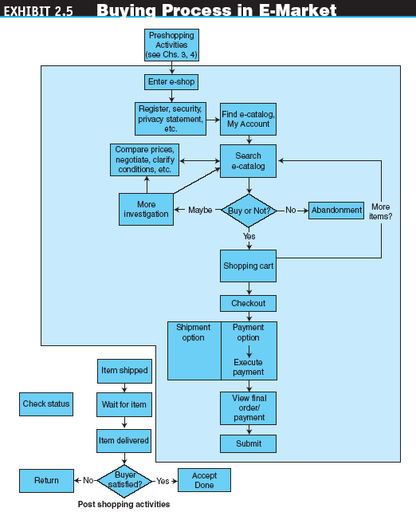
Transactions, Intermediation, and Process in E-Commerce

Slide 18
Electronic Catalogs and Other Market Mechanisms
electronic catalogs
The presentation of product information in an electronic form; the backbone of most e-selling sites
Three dimensions of electronic catalogs along which they are classified:
The dynamics of the information presentation
The degree of customization
Integration with business processes

Slide 19
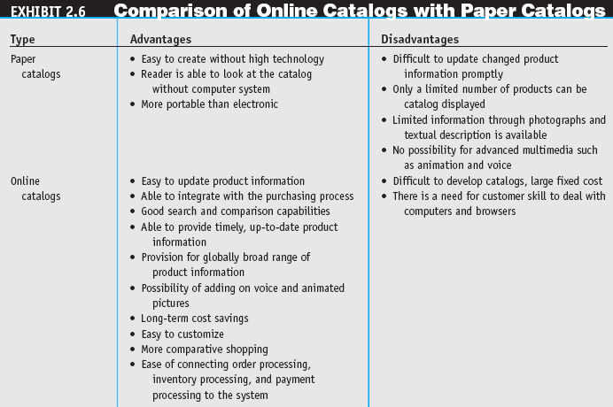
Electronic Catalogs and Other Market Mechanisms

Slide 20
Electronic Catalogs and Other Market Mechanisms
search engine
A computer program that can access databases of Internet resources, search for specific information or keywords, and report the results
software (intelligent) agent
Software that can perform routine tasks that require intelligence

Slide 21
Electronic Catalogs and Other Market Mechanisms
electronic shopping cart
An order-processing technology that allows customers to accumulate items they wish to buy while they continue to shop

Slide 22
Auctions as EC Market Mechanisms
auction
A competitive process in which a seller solicits consecutive bids from buyers (forward auctions) or a buyer solicits bids from sellers (backward auctions). Prices are determined dynamically by the bids

Slide 23
Auctions as EC Market Mechanisms
Traditional Auctions versus
E-Auctions
Limitations of traditional offline auctions
rapid process gives potential buyers little time to make a decision
electronic auction (e-auction)
Auctions conducted online
dynamic pricing
Prices that change based on supply and demand relationships at any given time

Slide 24
Auctions as EC Market Mechanisms
Types of Auctions
forward auction
An auction in which a seller entertains bids from buyers. Bidders increase price sequentially
reverse auction (bidding or tendering system)
Auction in which the buyer places an item for bid (tender) on a request for quote (RFQ) system, potential suppliers bid on the job, with the price reducing sequentially, and the lowest bid wins; primarily a B2B or G2B mechanism
“name-your-own-price” model
Auction model in which a would-be buyer specifies the price (and other terms) he or she is willing to pay to any willing and able seller. It is a C2B model that was pioneered by Priceline.com

Slide 25
Auctions as EC Market Mechanisms
Benefits of E-Auctions
Benefits to Sellers
Benefits to Buyers
Benefits to E-Auctioneers
Limitations of E-Auctions
Minimal security
Possibility of fraud
Limited participation

Slide 26
Auctions as EC Market Mechanisms
Impacts of Auctions
Auctions as a coordination mechanism
Auctions as a social mechanism to determine a price
Auctions as a highly visible distribution mechanism
Auctions as an EC component

Slide 27
Bartering and Negotiating Online
Online Bartering
bartering
The exchange of goods or services
e-bartering (electronic bartering)
Bartering conducted online, usually in a bartering exchange
bartering exchange
A marketplace in which an intermediary arranges barter transactions

Slide 28
Bartering and Negotiating Online
Online Negotiating
Negotiated pricing commonly is used for expensive or specialized products
Negotiated prices also are popular when large quantities are purchased
Much like auctions, negotiated prices result from interactions and bargaining among sellers and buyers

Slide 29
E-Commerce in the Wireless Environment
mobile computing
Use of portable devices, including smart cell phones, usually in a wireless environment. It permits real-time access to information, applications, and tools that, until recently, were accessible only from a desktop computer

Slide 30
E-Commerce in the Wireless Environment
mobile commerce (m-commerce)
E-commerce conducted via wireless devices
m-business
The broadest definition of m-commerce, in which e-business is conducted in a wireless environment

Slide 31
E-Commerce in the Wireless Environment
The Mobility Revolution
Organizations are embracing mobilized computing technologies for several reasons:
Improved productivity of workers in the field
Wireless telecom support for mobility is growing quickly
More applications can run both online and offline
The prices of notebook computers, wireless handhelds, and smart phones continue to fall as their capabilities increase

Slide 32
E-Commerce in the Wireless Environment
The Promise of M-Commerce
location-based commerce (LBC)
An m-commerce application targeted to a customer whose location, preferences, and needs are known in real time
M-Commerce Adoption
Although there are currently many hurdles to the widespread adoption of m-commerce, many companies are already shifting their strategy to the mobile world

Slide 33
Competition in the Digital Economy and Its Impact on Industries
differentiation
Providing a product or service that is unique
personalization
The ability to tailor a product, service, or Web content to specific user preferences

Slide 34
Managerial Issues
What about intermediaries?
Should we auction?
Should we barter?
What m-commerce opportunities are available?
How do we compete in the digital economy?
What organizational changes will be needed?

